Slide 1

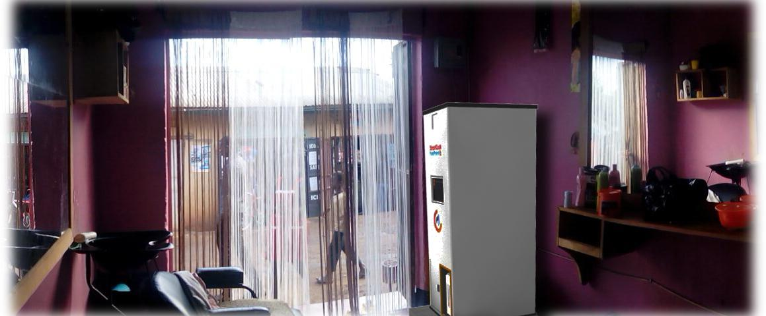
Koko Agent Loan Framework
March 2016
Proprietary and Confidential

Slide 2
Agent Loan Models
 | Who acquires the agent? | Who collects the FP deposit (the FP price - loan amount)? | What does the repayment profile look like? | Who collects the loan?
Journey A (KOKO loan) | KOKO Networks | Agent pays deposit deposit to KOKO | Deduct a percentage of the commission paid at the end of the month And or Set a minimum monthly repayment amount | KOKO Networks
Journey B (Business cash advance) | KOKO Networks | Agent pays deposit to KOKO | Deduct a percentage of the merchant future stock sales until the loan is cleared And or Set a minimum monthly repayment amount | Partner
Journey C (Business loan) | KOKO networks | Agent pays deposit deposit to KOKO | Agent and partner agree on a minimum monthly repayment amount until the loan is cleared | Partner

Slide 3
Customer Information Exchange
Data from Acquisition channels
Pre-disbursement conditions
Disbursement
Repayments
KOKO will Share agent application and supporting data via secure medium
* KOKO and partner will agree on the minimum KYC requirements for agent sign up
Partner will collect any additional information needed
Partner will ensure all the conditions set have been fulfilled
Loan request is submitted for underwriting and scoring
Partner will disburse successful loan requests
Partner notifies KOKO of the disbursed loans and transfers the funds to KOKO
KOKO notifies the customer of the successful loan application
Agent pays deposit and KOKO point is delivered
KOKO and Partner to have a monthly catch to review the progress of the repayments
*KOKO and Partner to agree on how to handle late repayments and defaults

Slide 4
Movement Of Money
 | Movement of funds before FP is delivered | Movement of funds after the FP is delivered (KOKO & PARTNER account reconciliation)
JOURNEY A | KOKO Signs up an agent KOKO receives agent deposit and loan application KOKO assesses and disburses the loan | KOKO collects the repayments until the loan is fully paid
JOURNEY B | KOKO will Signs up an agent KOKO shares the loan request details with the Partner Partner assesses loan and agrees terms with the agent Partner issues loans and sends the funds to KOKO Agent pays deposit to KOKO KOKO delivers the Fuel point to the agent | Repayments collected by Partner according to the agreed terms.
JOURNEY C

Slide 5
Real-World Process - New Agent
Journey B - Jane. - Let's assume that KOKO Fuel Point costs Ksh 200,000.
Jane sees the KOKO Fuel Point at a friends salon, and signs up on the KOKO webpage to become a retailer herself. During the sign-up process, she expresses interest in an Fuel Point loan to pay for the equipment. KOKO receives the loan application and contacts Jane to complete the KYC information and loan qualification requirements. KOKO sends the loan request and supporting information to the financing partner. After scoring, the financing partner approves Jane for a KSh 120,000 loan and notifies her. Jane saves for the remaining KSh 80,000 deposit required over the next few weeks, adding small payments to her new KOKO account. When Jane's KOKO account balance reaches KSh 80,000, KOKO informs partner. Partner sends the Ksh 120,000 loan amount to KOKO to complete the purchase. On receipt of the loan, KOKO credits Jane's account and arranges for the Fuel Point to be delivered.

Slide 6
Real-World Example - New Customer With Partner Account Holder
Journey C - Peter. - Let's assume that KOKO Fuel point costs Ksh 200,000.
Peter has an account with partner A and having seen the Fuel Point marketing on partner A's website, he's interested in getting one with a partner A loan. He logins into his business online account with partner A and checks how much his business qualifies for. Luckily the partner loan offer for Peter's business stands at Ksh 150,000. Peter contacts partner A and informs them of his intention to buy a Fuel Point and the next steps. Partner A sends informs KOKO of the new customer for KOKO to arrange for a follow up and possible site visit. KOKO approves Peter's business for a Fuel Point franchise and requires him to deposit Ksh 50,000 into his account and proceed to apply for partner A's business loan. When the deposit is received and the loan is received, by KOKO starts the process of delivering the Fuel Point equipments to Peter's.

